Slide 1
3 Days in English

Slide 4
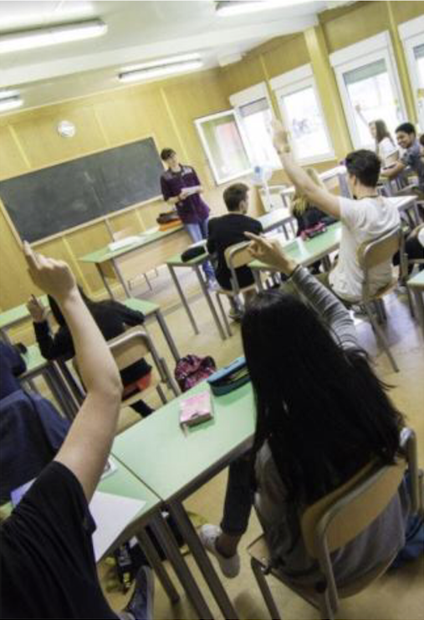
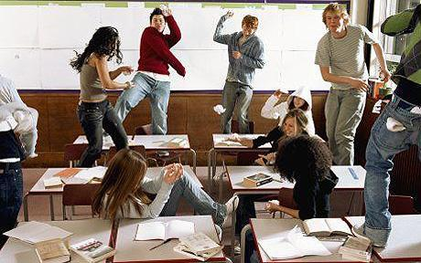
RULES :
BEHAVE YOURSELF

Slide 5
SPEAK ENGLISH ANY TIME

Slide 6
workshops

Slide 7
Talking t- shirts

Slide 8
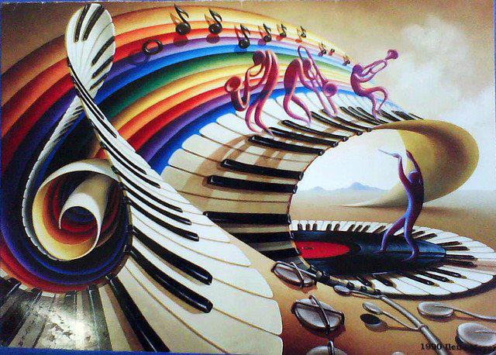
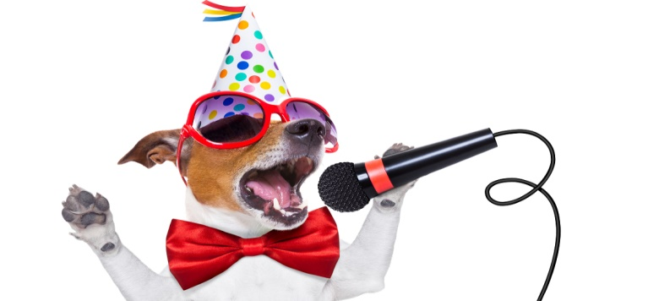
MUSIC MANIA
MASTER CHEF

Slide 9
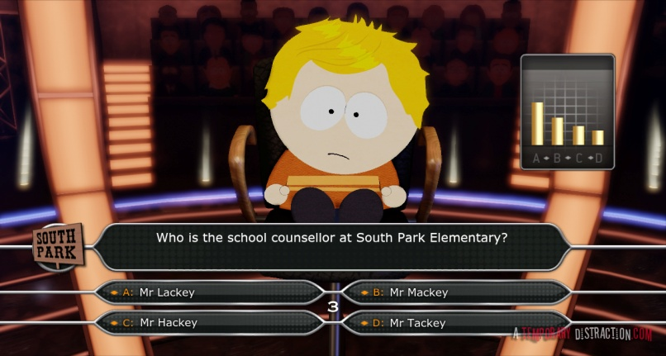
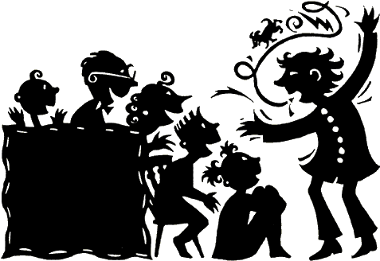
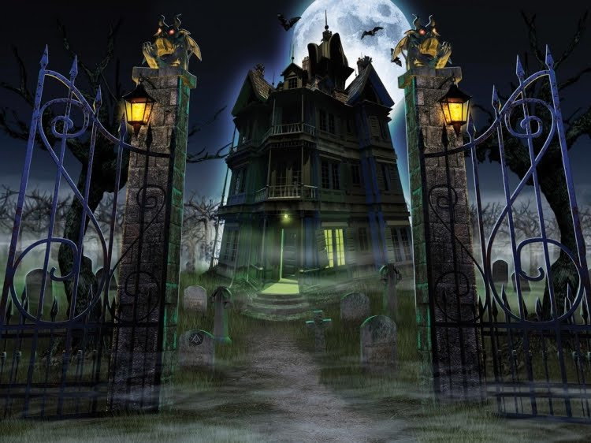
THE MILLIONAIRE
TRAFFICLIGHTS
STORY TELLING

Slide 10
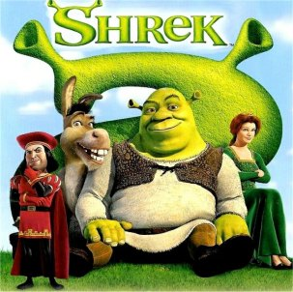
GREESE AND SHREK
DUBBING !!!.....
…. AND ACTING !!

Slide 11
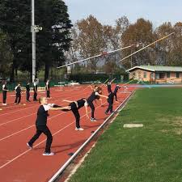
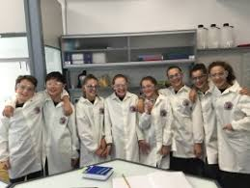

Slide 12
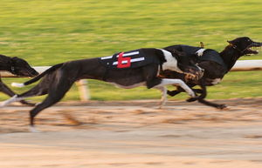
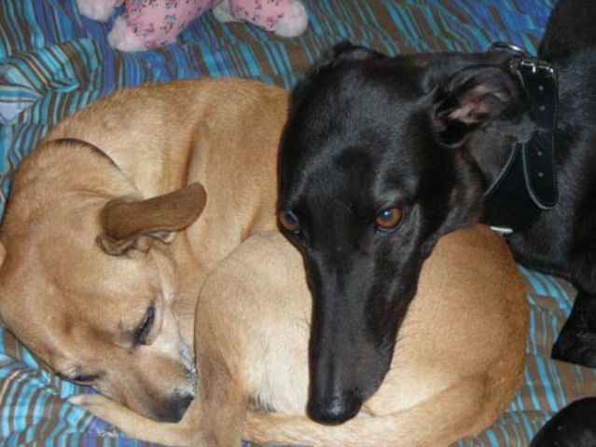
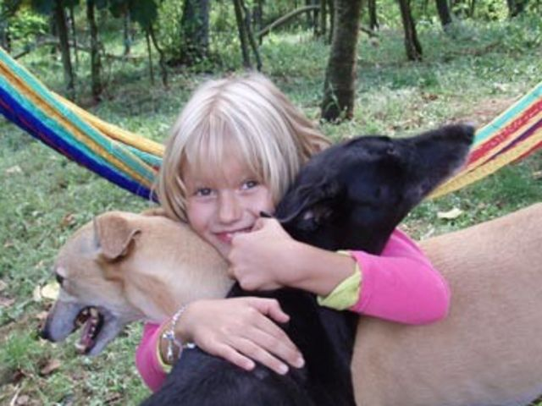
GACI

Slide 13
ON Thursday 21th
LET’S GO TO THE THEATRE AND ENJOY…….

Slide 14
Palketto stage in…

